Slide 1

Protecting Artists’ Rights in the Age of AI
Reema Selhi
Head of Policy and International
DACS – Design and Artists Copyright Society

Slide 2
Introduction to DACS
Collective rights management organisation established in 1984
Managing rights of visual artists including:
  Fine artists (sculptors, painters, works selling on art market)
  Photographers, illustrators, ‘commercial’ artists
Licensing © in artists’ works through collective licensing schemes (secondary uses), direct licensing (e.g. book publishing) and Artist’s Resale Right
Policy work: engaging with Government to ensure a fair and robust © framework for artists

Slide 3
AI and IP – key touch points for visual artists
Artworks used in AI training
Cases brought in USA and main court case in UK is in respect of visual art works
Issue of ‘style’
Lack of consent, credit and compensation
Impact on artistic practice, opportunities, skills and work

Slide 4
1. AI training and using artists’ works
Leaked list of 16,000 artists’ works used for training Midjourney
‘Have I Been Trained’ site: over 2 billion images identified as being used in AI training dataset LAION 5B
Cases in USA and UK relating to AI and IP (around 30)
Text and data mining exceptions
  UK: narrow, attempt to widen suggested by last Government, resisted by industry
  EU: wider exception providing for an opt-out
  Scope of EU exception: study considers AI training different to TDM
Notes:
The 24-page list of artists’ names used by Midjourney as the training foundation for its AI image generator (Exhibit J) includes modern and contemporary blue-chip names,as well as commercially successfully illustrators for companies like Hasbro and Nintendo. Notable artists include Cy Twombly, Andy Warhol, Anish Kapoor, Yayoi Kusama, Gerhard Richter, Frida Kahlo, Andy Warhol, Ellsworth Kelly, Damien Hirst, Amedeo Modigliani, Pablo Picasso, Paul Signac, Norman Rockwell, Paul Cézanne, Banksy, Walt Disney, and Vincent van Gogh.

Slide 5
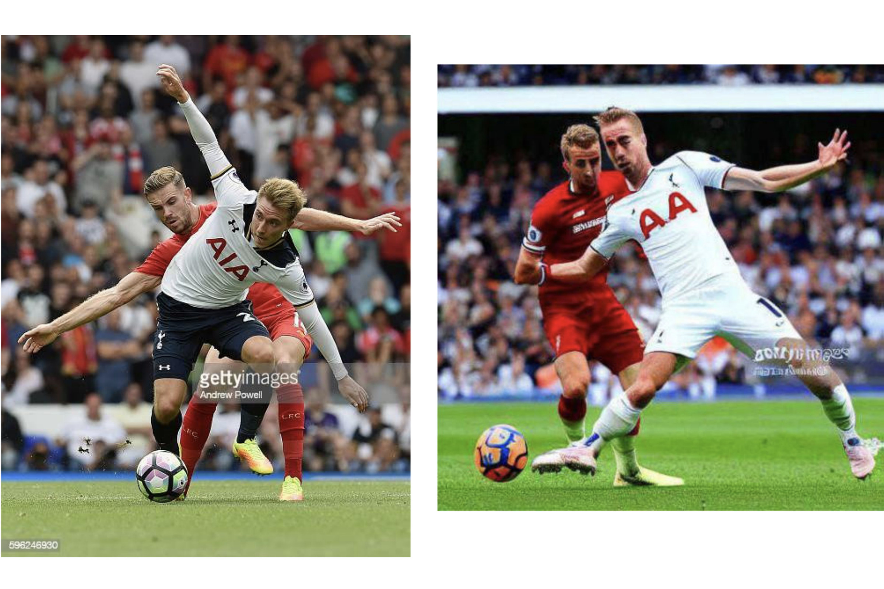
2. UK case: Getty v Stability AI
Stable Diffusion
© Getty Images
Notes:
For now this case of Getty Images against Stability AI remains the main case brought in the UK against an AI for IP violations.
the basis on which Getty sued Stability AI here in the UK and the US are Copyright Infringement, Database Right Infringement and Trademark Infringement.
As many of you may know, Stability AI scraped the web for training purposes of it’s AI Stability Diffusion and amongst others, it scraped and copied millions of works owned or controlled by Getty.
The copyright claim is based on the ingestion of million of images for training purposes, the input; but also on the communication to the public and in some instances substantial taking, the output; as well as secondary infringement for making a tool for infringements, Stable Diffusion, available to the public; the database claim comprises, the visual assets, the captions, rightsholder information and other metadata, and claims extracting and re-utilizing of data; and the trademark claim goes for trademark infringement and passing off, because of identical and similar signs being used in identical goods and services, but also that Stability AI is taking unfair advantage of the Getty trademark to the detriment of its distinctive character.
Stability puts forward the defence that training took place outside of the UK; the outputs relied upon are willful contrivance by the claimant, that it relies upon safe harbour over the prompts made by users and asserts that there is fair dealing defence of pastiche. The defendents applied fro summary judgment last winter, which was rejected. T

Slide 6
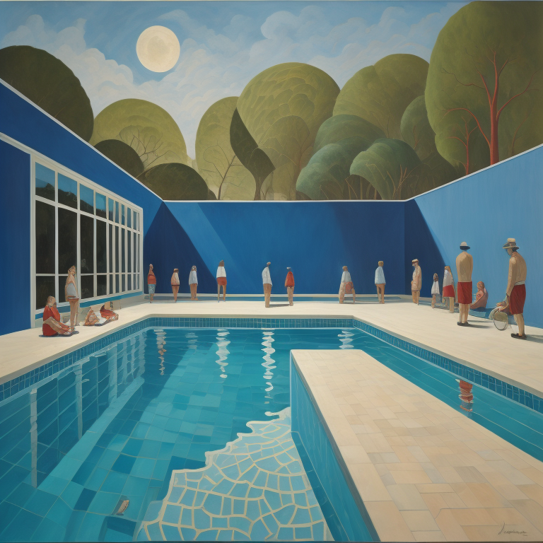
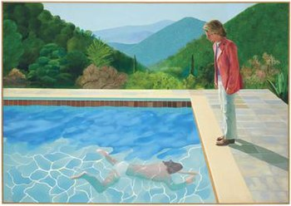
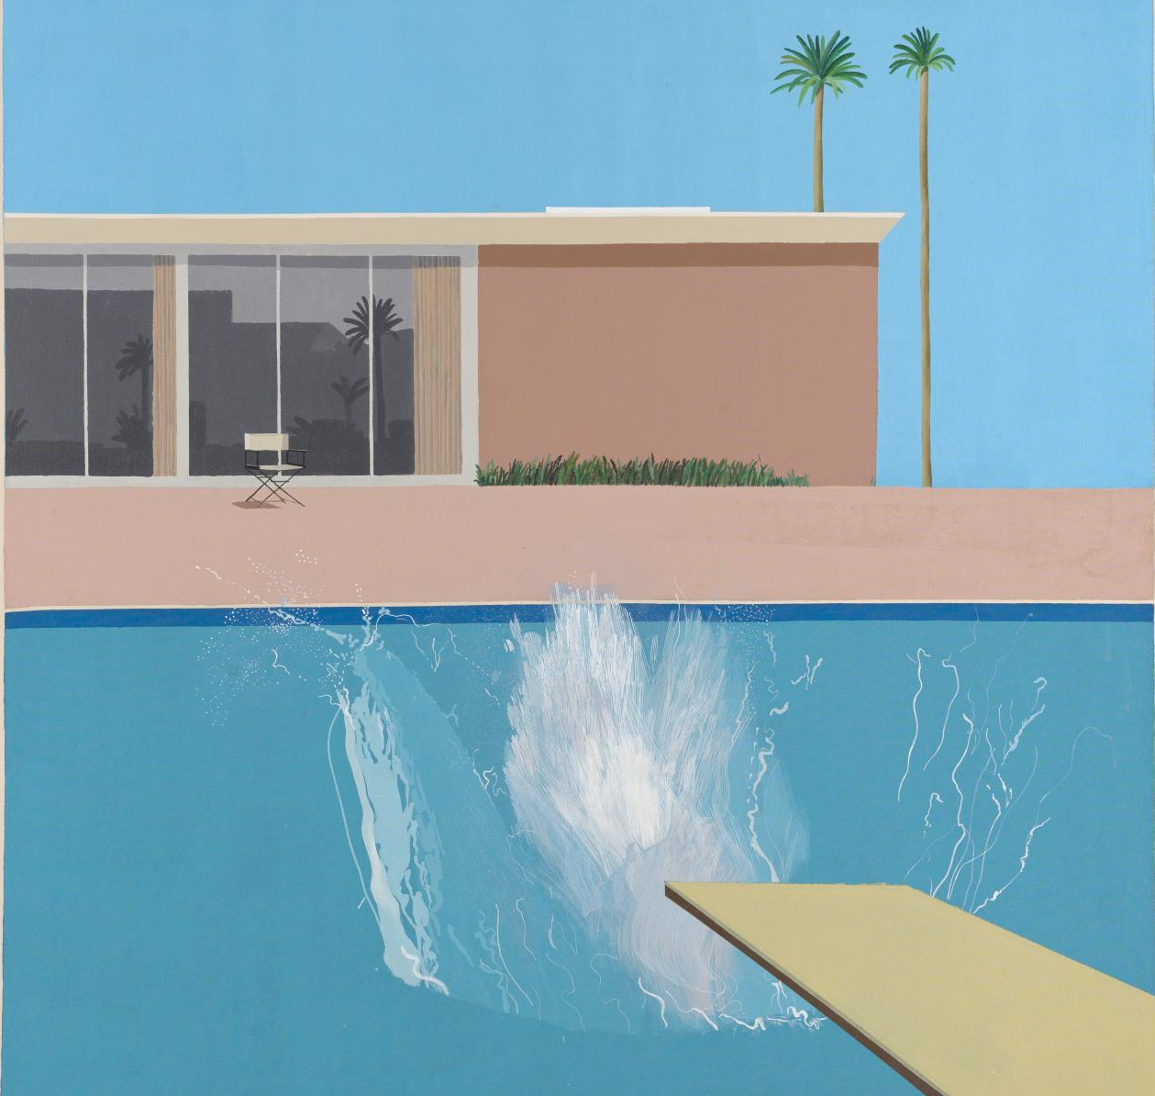
3. Artists’ styles
© David Hockney
Prompt: Painting David Hockney pool with men – Imagine AI Art Generator
Notes:
I also want to quickly talk about the output and the issue that the style of an artist is generally not protected. In this example here you can easily see that the AI generated image borrows a lot from the originals. But in the UK traditionally without being able to show substantial taking from the original, infringement is difficult to establish, because the style itself is not protected and this is what a lot of AI outputs will do.
There is hope though, because in recent copyright case law, UK courts seem to accept that copying has occurred when something has the same look and feel, like in the Red bus case.

Slide 7
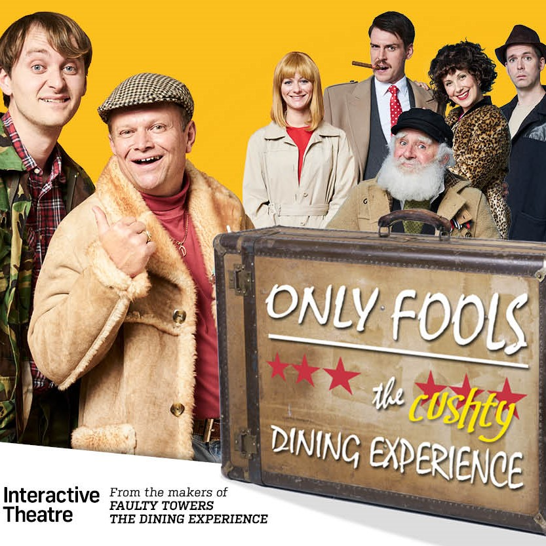
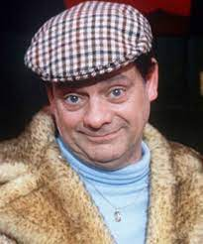
3. Artists’ style
Notes:
In a case called Shazam vs Only Fools the Dining Experience, the first case under UK law about the copyright protection in a character, the court found that Del Boy’s back story, relationships with other OFDE characters, use of mangled French, catchphrases (such as "lovely jubbly") and involvement in dodgy schemes in the OFDE script were all copied from the OFAH episodes. This too suggested that UK courts are more and more inclined to protect a general likeness as opposed to a substantial taking in the classical sense.

Slide 8
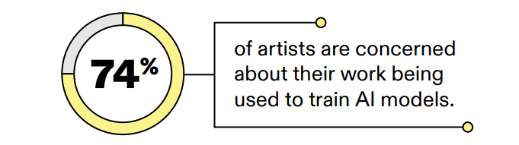
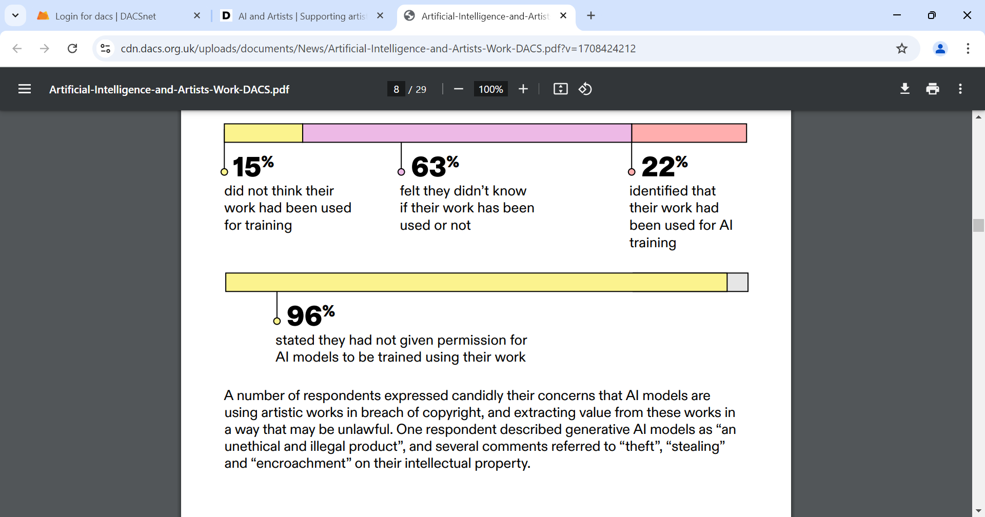
4. Consent, credit, compensation

Slide 9
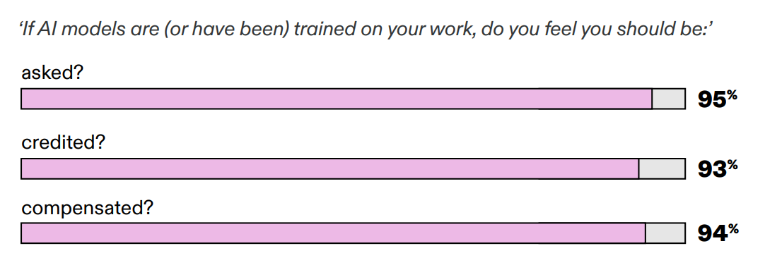
4. Consent, credit, compensation

Slide 10
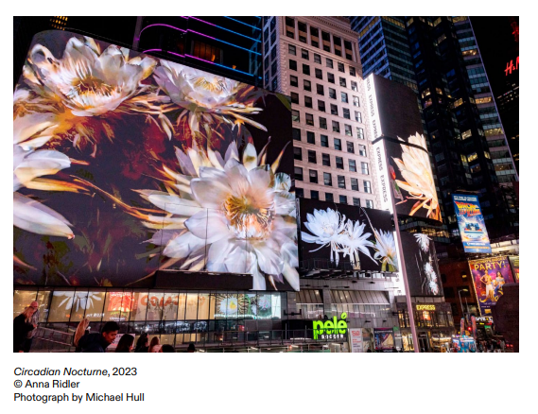
5. Impact on artists and industry
Using complex algorithms to explore non-human ways of keeping time, Circadian Nocturne features AI-generated animations of night-blooming and night-scented flora.
Created with artificial intelligence and a high-tech machine that can keep time at an atomic level the work pairs highly precise computerized timekeeping methods with the often unpredictable and imprecise imagery created by autonomous digital software and is part of an ongoing project exploring time and technology.
Ridler visually obscures tech-based accuracy with something more organic and in sync with the natural landscape.
Notes:
Using complex algorithms to explore non-human ways of keeping time, Circadian Nocturne features AIgenerated animations of night-blooming and night-scented flora. Created with artificial intelligence and a high-tech machine that can keep time at an atomic level the work pairs highly precise computerized timekeeping methods with the often unpredictable and imprecise imagery created by autonomous digital software and is part of an ongoing project exploring time and technology. Ridler visually obscures techbased accuracy with something more organic and in sync with the natural landscape

Slide 11
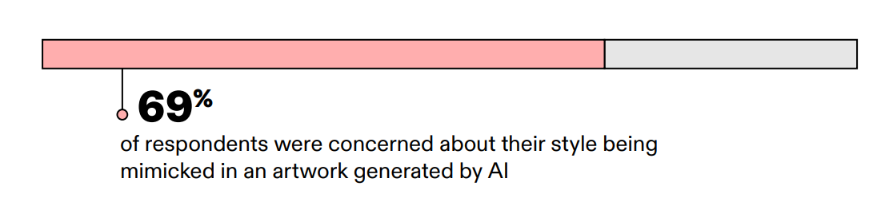
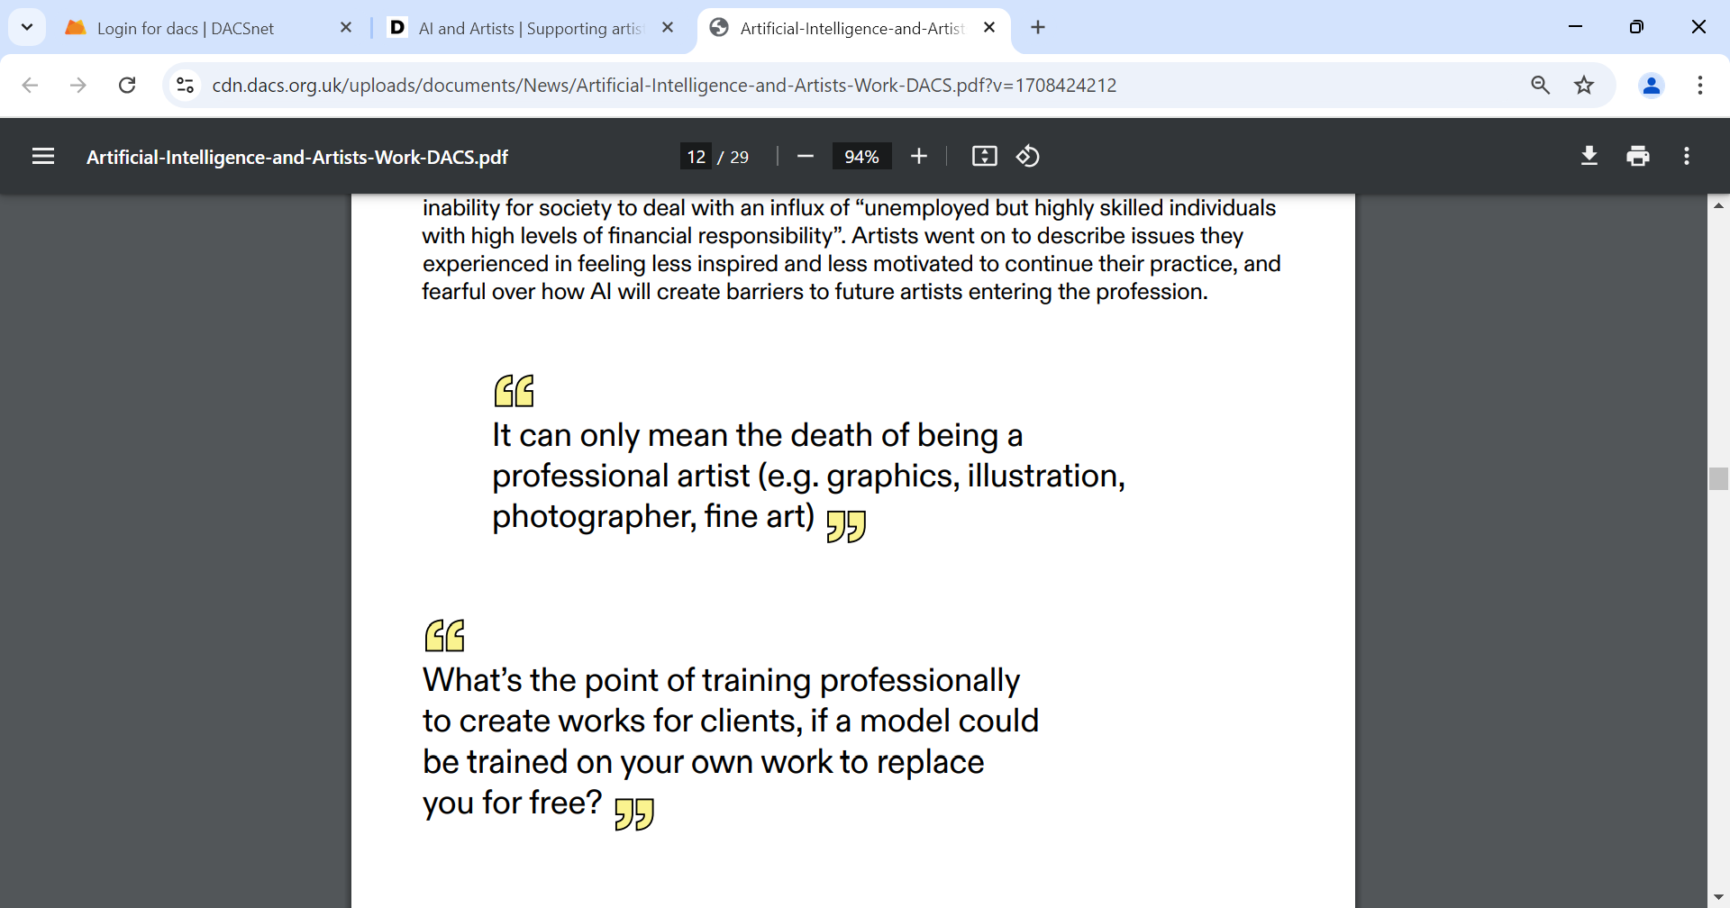
5. Impact on artists and industry

Slide 12
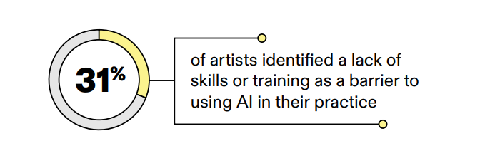
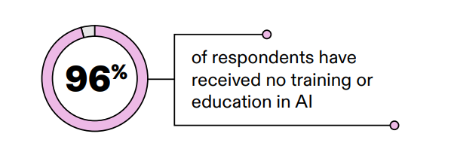
5. Impact on artists and industry

Slide 13
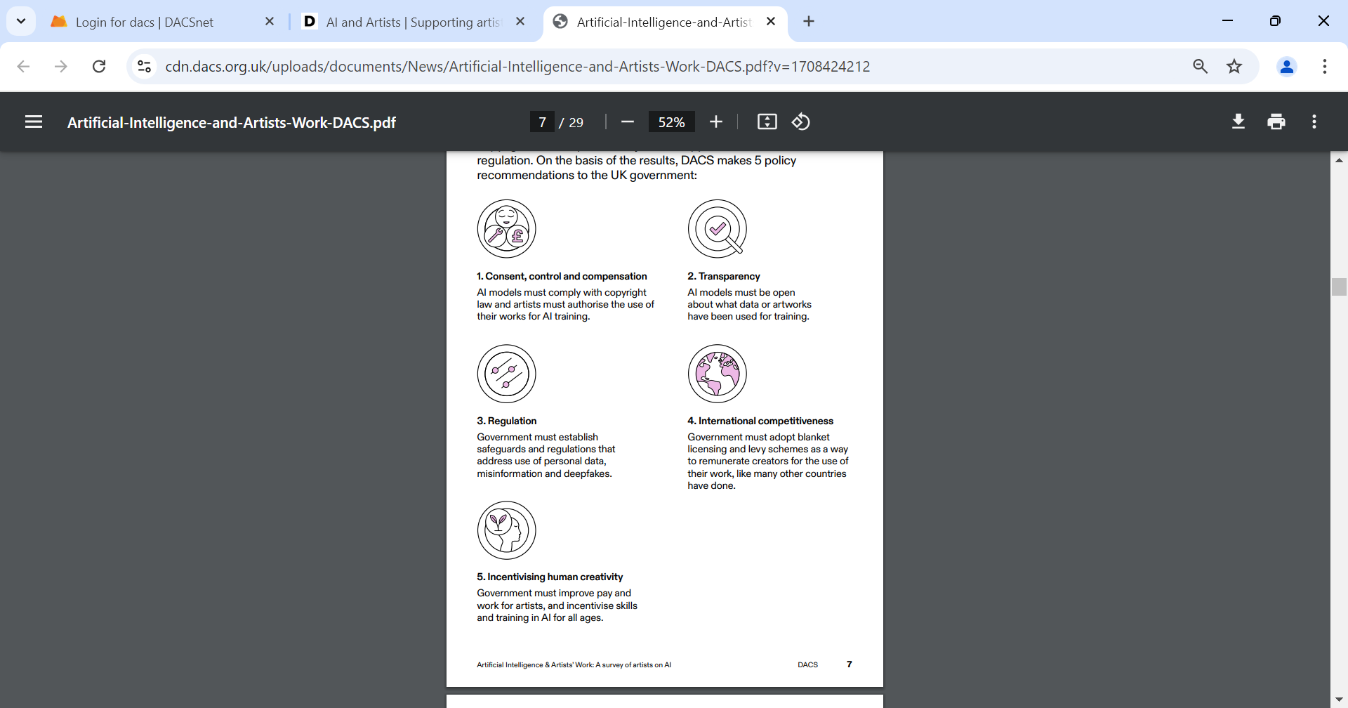
Where do we go from here?

Slide 14
Thank you
More information:
www.dacs.org.uk/advocacy/ai-and-artists
@dacsforartists

Slide 15
ARTIFICIAL INTELLIGENCE & CONNOISSEURSHIP
COCHRANE ADAMS
FINE ART AGENTS
Charles Cochrane

Slide 16
COCHRANE ADAMS
FINE ART AGENTS
Connoisseurship
Society of Dilettanti, 18th Century London
Aesthetics, Archaeology, Grand Tour
Neoclassicism, Royal Academy

Slide 17

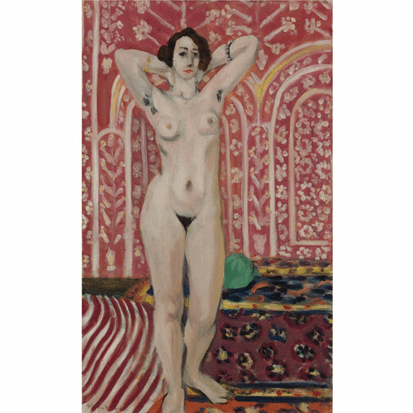
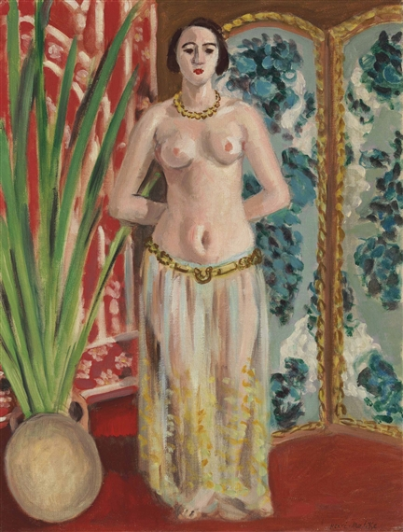
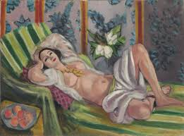

Slide 18
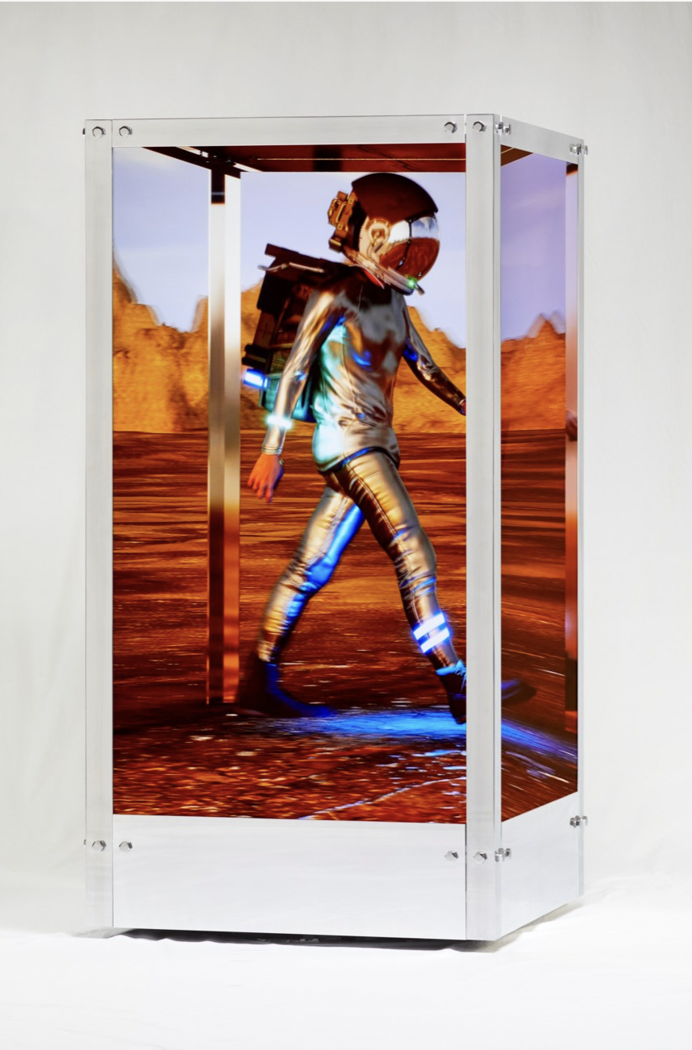
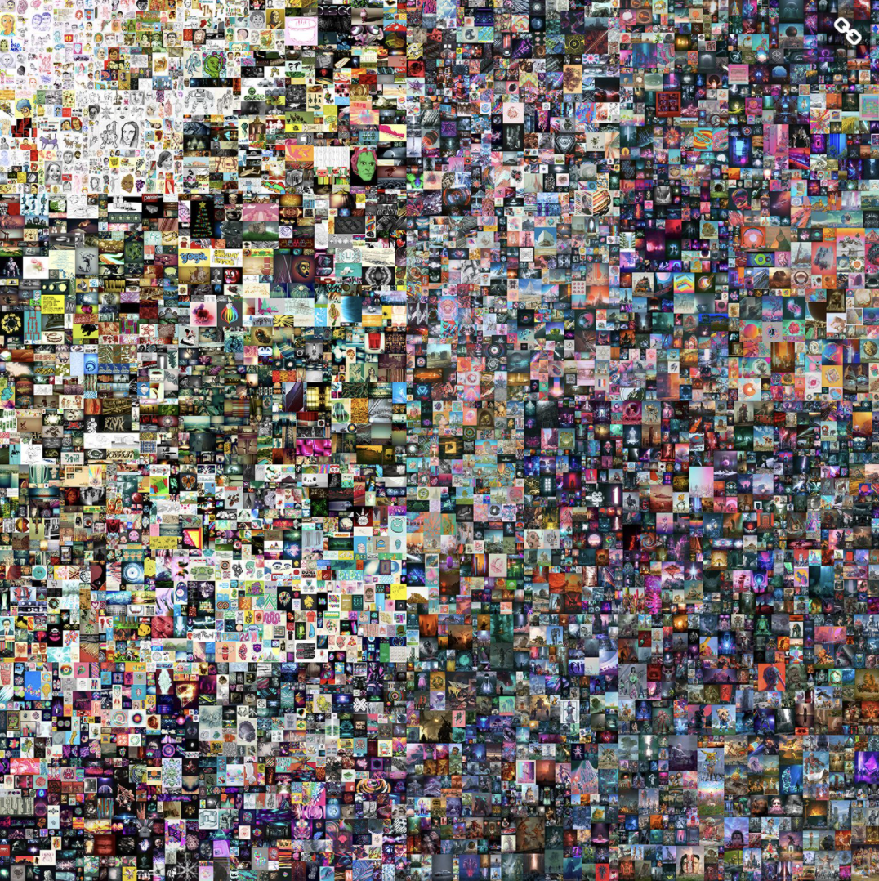
Christie’s, 21st Century Evening Sale
New York, 09 November 2021
Lot 7a, Beeple (B. 1981), Human One, 2021
kinetic video sculpture
Estimate on request. Lot sold: 28,985,000 USD
(inclu. Premium)
Christie’s, online
New York, 11 March 2021
Lot 1, Beeple, Every Days: The First 5000 Days One, 2021
Estimate unknown. Lot sold: 69,356,250 USD
(inclu. Premium)
Image © Christie’s

Slide 19
COCHRANE ADAMS
FINE ART AGENTS
  AI & ART
  Pick images and amend
  2. Existing Images and Tagging meaning/labelling
  MOMA Algorhythms – Black Box
  3. Politics/Control/Bias/Corporations – 1984/Brave New World?
  4. Real/Unreal/Artist/Machine
  5. Artists – People/Machine?
  6. Connoisseurship?

Slide 20
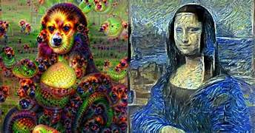

Slide 21
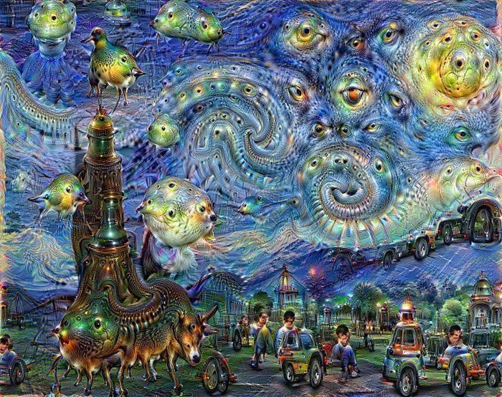

Slide 22
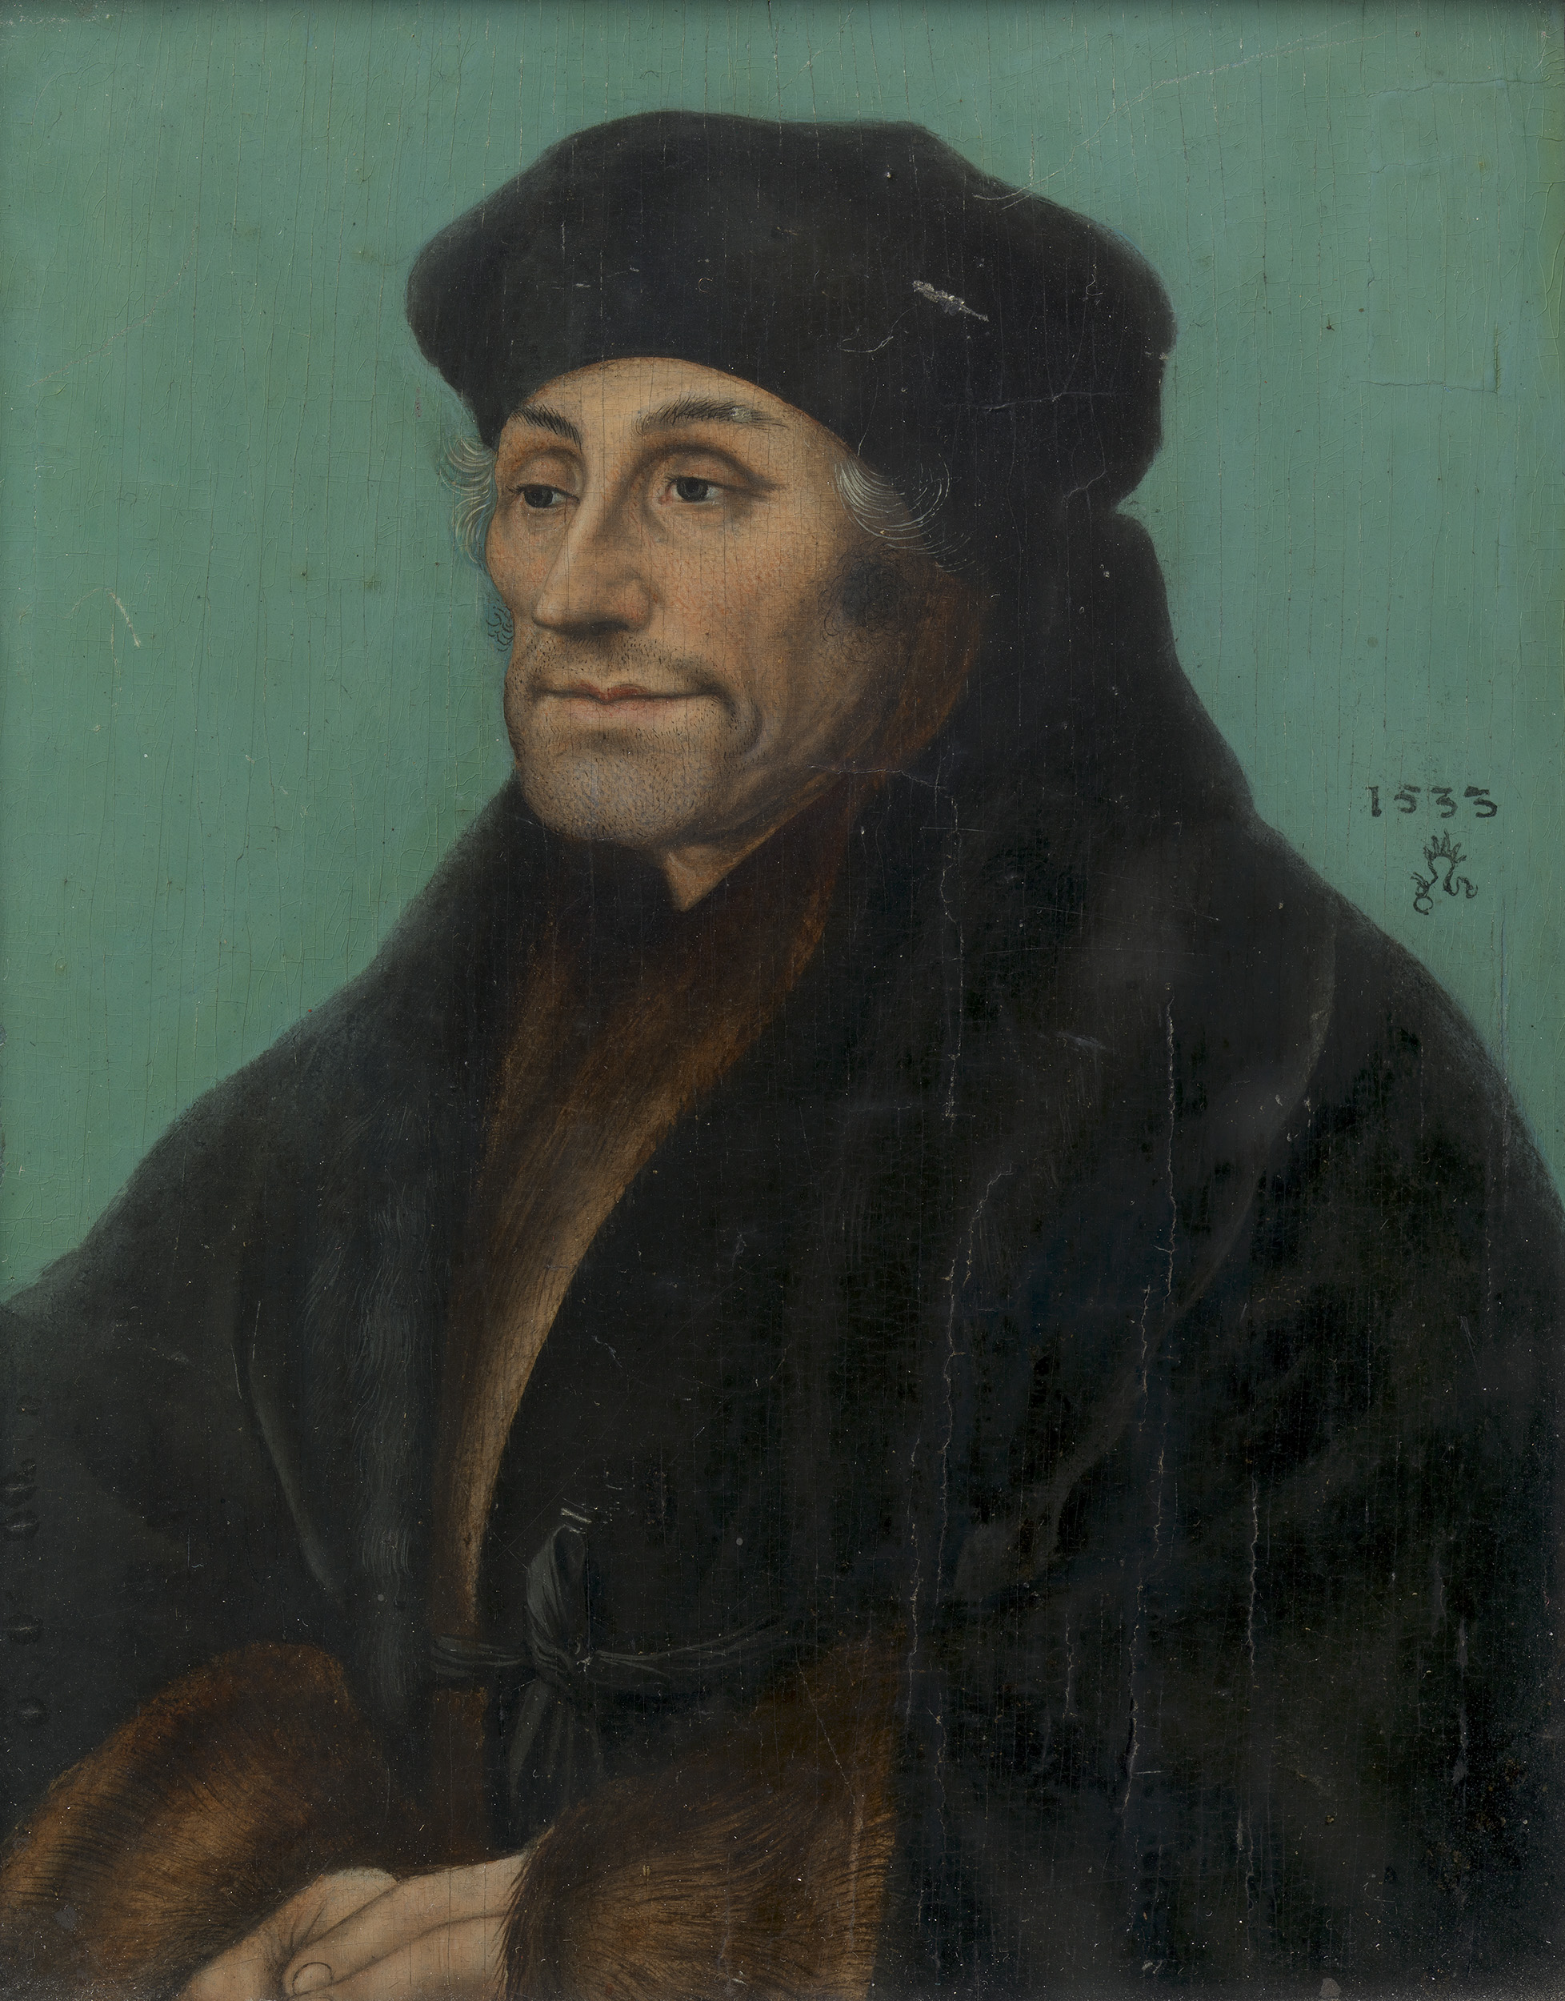

Slide 23
COCHRANE ADAMS
FINE ART AGENTS
Charles Cochrane
charles@cochrane-adams.com
+44 (0)7480 048 688 / +44 (0)203 095 5120
8 Hill Street
London
W1J 5NG
www.cochrane-adams.com

